Slide 1
Introduction
Notes:
Hello there!

Slide 2
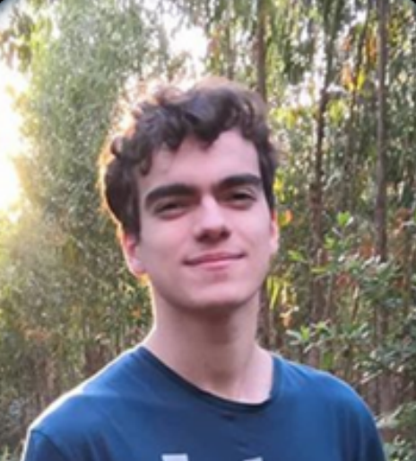



Rafael
Notes:
My name is Rafael

Slide 3
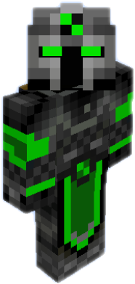
Also know as:
BlackKnight625
Notes:
AKA BlackKnight625

Slide 4
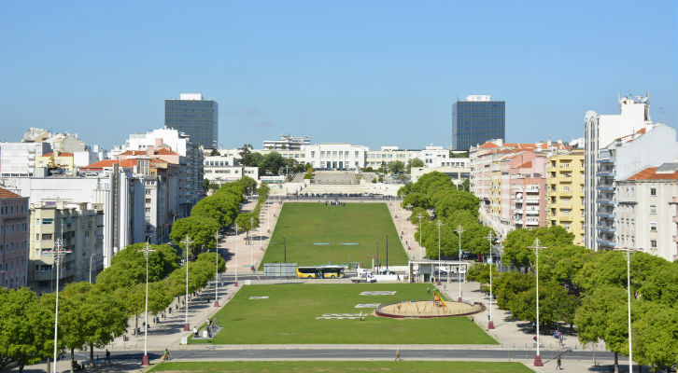

Instituto Superior Técnico
Technical Superior Institute
Notes:
I’m currently in my 4th year in University in Portugal (not Spain). I’m studying at Instituto Superior Técnico

Slide 5


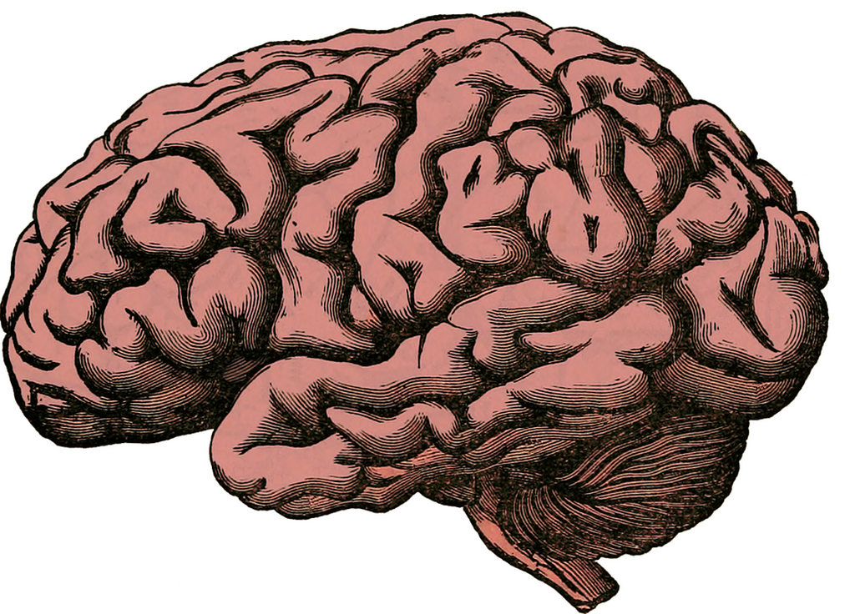



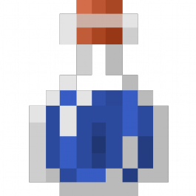
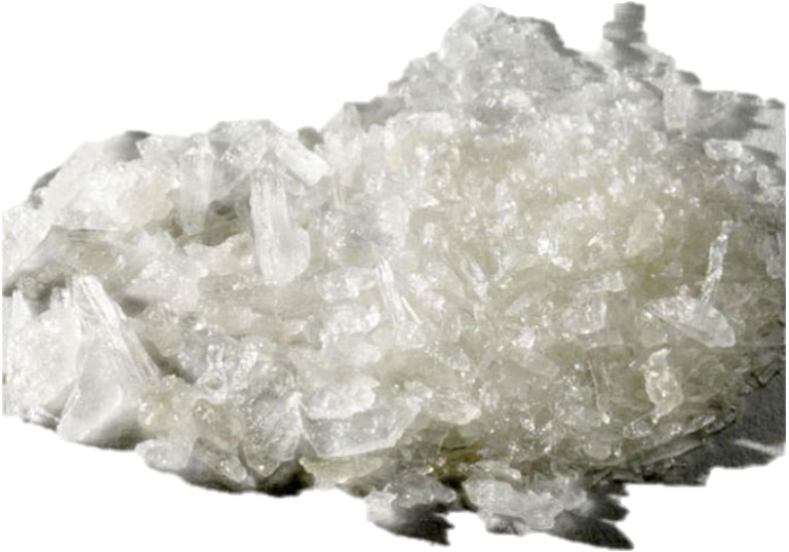

General knowledge
Meth
Notes:
University has taught me Physics, Programming in general, and Meth… Ohh, I meatn Math!

Slide 6


Master’s Degree
Master’s Thesis:
Minecraft Social Agents
Notes:
I’m currently in the 1st year of my Master’s Degree, specializing in Artificial Intelligence and Game Development. My Master Thesis’ theme is “Minecraft Social Agents”

Slide 7
Lecture’s Structure
Sub-topic
Topic
Sub-topic
Sub-topic
Notes:
Lecture topics will be sub-divided into Topics

Slide 8

Sub-topic
1- Motivation
2- Theory
3- Examples
4- Exercises
5- Applications
https://github.com/DotWavPresents/Lectures
Notes:
Each sub-topic will follow this structure. Most of the exercises that I’ll be giving you can be found on this github page. Please do not look into the solutions.

Slide 9
The end!

